Slide 1
Buses 4

Slide 2
Requirements of our program
We are building a new city, which obviously will have buses. We want to understand the optimal pathing's for the buses. The city can be represented as an ordered graph with N vertices as crossroads and M edges as the streets, where each street has an assigned number to it - the time it takes to drive through that street in minutes. The program should support several operations.
1.Find and Construct the shortest pathing for a new bus starting at crossroad A and with potential destinations at crossroads B1, B2, …, Bk. The operation should have O(k) complexity.
2. Add a new crossroad A with corresponding streets. All existing paths for buses should be updated accordingly and the operation should have O(N^2) complexity. Note that the destination may also change. After updating the paths, you need to select the best destination for each bus from their initial list.
3. Common streets between I-th and J-th bus paths. The operation should have O(MlogN) complexity.

Slide 3
Libraries, structures and defining variables that we will use in our program
#include <iostream>
#include <vector>
#include <limits>
#include <algorithm>
#include <queue>
using namespace std;
const int INF = numeric_limits<int>::max();
struct Edge {
int to; // Destination vertex
int weight; // Weight of the edge
};

Slide 4
Graph implementation
int N, M;
cin >> N >> M; // Input number of vertices and edges
vector<vector<Edge>> graph(N); // Adjacency list representation of the graph
// Input edges and weights
for (int i = 0; i < M; ++i) {
int u, v, k;
cin >> u >> v >> k;
graph[u].push_back({v, k}); // Add directed edge from u to v with weight k
}

Slide 5
For shortest path we will use Floyd-Warshall’s algorithm. Algorithm implementation
// Function to compute all pairs shortest paths using Floyd Warshall algorithm
vector<vector<int>> floydWarshall(const vector<vector<Edge>>& graph, int n) {
// Initialize distance matrix with maximum values
vector<vector<int>> dist(n, vector<int>(n, INF));
// Update distances with edge weights
for (int i = 0; i < n; ++i) {
for (const Edge& edge : graph[i]) {
dist[i][edge.to] = edge.weight;
}
}

Slide 6
// Floyd Warshall algorithm
for (int k = 0; k < n; ++k) {
for (int i = 0; i < n; ++i) {
for (int j = 0; j < n; ++j) {
if (dist[i][k] != INF && dist[k][j] != INF && dist[i][k] + dist[k][j] < dist[i][j]) {
dist[i][j] = dist[i][k] + dist[k][j];
}
}
}
}
return dist; // Return all pairs shortest paths matrix
}

Slide 7
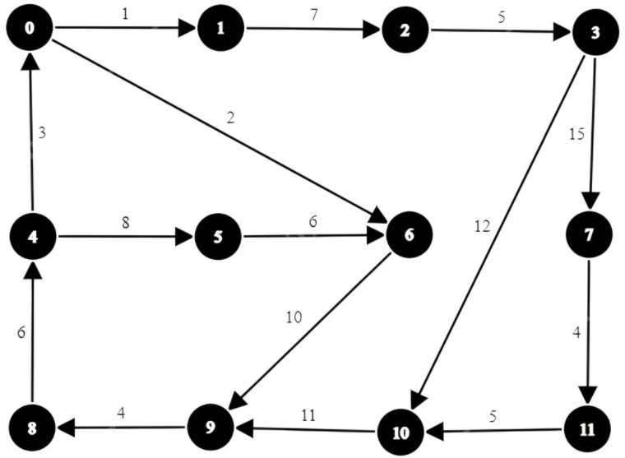
Floyd-Warshall’s algorithm on our Graph
 | 0 | 1 | 2 | 3 | 4 | 5 | 6 | 7 | 8 | 9 | 10 | 11
0 | 0 | 1 | 8 | 13 | 22 | 30 | 2 | 28 | 16 | 12 | 25 | 32
1 | 48 | 0 | 7 | 12 | 45 | 53 | 59 | 27 | 39 | 35 | 24 | 31
2 | 41 | 42 | 49 | 5 | 38 | 46 | 52 | 18 | 32 | 28 | 17 | 24
3 | 36 | 37 | 44 | 0 | 33 | 41 | 47 | 15 | 27 | 23 | 12 | 19
4 | 3 | 4 | 11 | 16 | 0 | 8 | 14 | 31 | 19 | 24 | 28 | 35
5 | 29 | 30 | 37 | 42 | 26 | 0 | 6 | 21 | 22 | 16 | 17 | 23
6 | 5 | 6 | 13 | 18 | 20 | 28 | 0 | 51 | 14 | 10 | 48 | 55
7 | 33 | 34 | 41 | 46 | 30 | 38 | 44 | 0 | 24 | 20 | 9 | 4
8 | 9 | 10 | 17 | 22 | 6 | 14 | 20 | 16 | 37 | 30 | 34 | 41
9 | 13 | 14 | 21 | 26 | 10 | 18 | 24 | 41 | 4 | 0 | 38 | 45
10 | 24 | 25 | 32 | 37 | 21 | 29 | 35 | 52 | 15 | 11 | 0 | 56
11 | 29 | 30 | 37 | 42 | 26 | 34 | 40 | 57 | 20 | 16 | 5 | 61

Slide 8
Add Bus operation
// Compute all pairs shortest paths using Floyd Warshall algorithm
vector<vector<int>> shortestPaths = floydWarshall(graph, N);
vector<vector<pair<int, int>>> buses; // Vector to store buses and their destinations
string operation; // Operation to perform
while (cin >> operation) {
if (operation == "add_bus") {
int k, A;
cin >> k >> A; // Input number of destinations and starting vertex
vector<pair<int, int>> destination_times; // Vector to store destinations and durations
// Input destinations and initialize durations to 0
for (int i = 0; i < k; ++i) {
int B;
cin >> B;
destination_times.push_back({B, 0}); // Add destination with initial duration 0
}
cout << endl;
cout << "Bus " << buses.size() << " updated destinations and durations:" << endl;

Slide 9
// Update durations and print updated destinations and durations
for (const auto& dest_time : destination_times) {
int destination = dest_time.first;
int duration = shortestPaths[A][destination]; // Duration from starting vertex to destination
cout << "Destination: " << destination << ", Duration: " << duration << endl;
}
buses.push_back(destination_times); // Add bus with updated destinations and durations
}

Slide 10
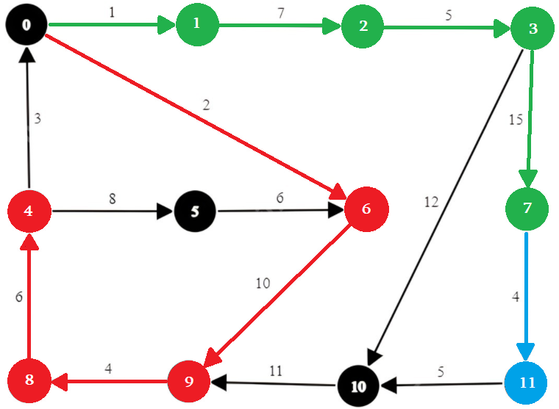
add_bus 3 0 4 7 11 ( 0->4, 0->7, 0->11)
Our program will have this output Bus 0 updated destinations and durations:
Destination: 4, Duration: 22
Destination: 7, Duration: 28
Destination: 11, Duration: 32

Slide 11
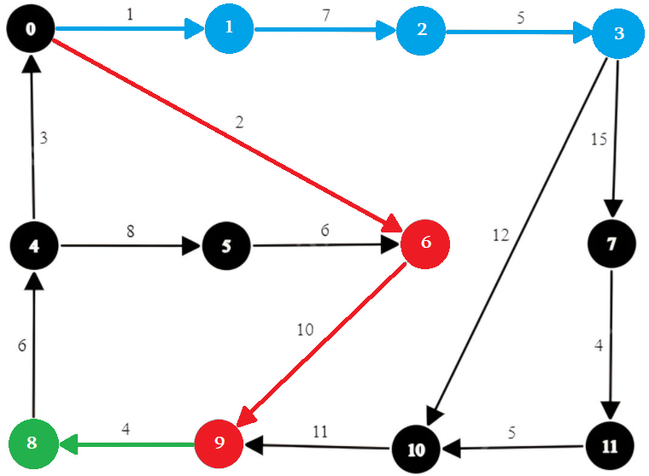
add_bus 3 0 9 3 8 ( 0->9, 0->3, 0->8)
Our program will have this output Bus 1 updated destinations and durations:
Destination: 9, Duration: 12
Destination: 3, Duration: 13
Destination: 8, Duration: 16

Slide 12
Construct Crossroad operation
else if (operation == "construct_crossroad") {
int k;
cin >> k; // Input number of crossroads
vector<int> newCrossRoad(k * 3); // Vector to store crossroads
// Input crossroads
for (int i = 0; i < 3 * k; i++) {
cin >> newCrossRoad[i];
}
cout << endl;
// Update graph with new crossroads
for (int i = 0; i < k; i++) {
int u = newCrossRoad[i * 3];
int v = newCrossRoad[i * 3 + 1];
int duration = newCrossRoad[i * 3 + 2];
graph[u].push_back({v, duration}); // Add directed edge from u to v with weight duration
}

Slide 13
// Recompute all pairs shortest paths using Floyd Warshall algorithm
shortestPaths.assign(N, vector<int>(N, 0));
shortestPaths = floydWarshall(graph, N);
// Print updated destinations and durations for each bus
for (const auto& bus : buses) {
cout << "Bus " << (&bus - &buses[0]) << " updated destinations and durations:" << endl;
for (const auto& dest_time : bus) {
int destination = dest_time.first;
int duration = shortestPaths[dest_time.second][destination]; // Duration from source to destination
cout << "Destination: " << destination << ", Duration: " << duration << endl;
}
cout << endl;
}
}

Slide 14
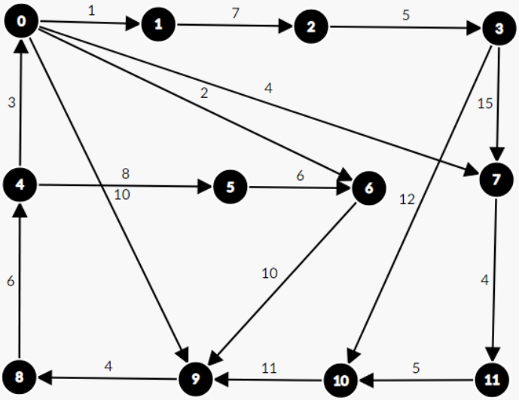
construct_crossroad 2 0 9 10 0 7 4 it means 2 new roads 0->9 with 10 duration and 0->7 with 4 duration Our graph will look like this

Slide 15
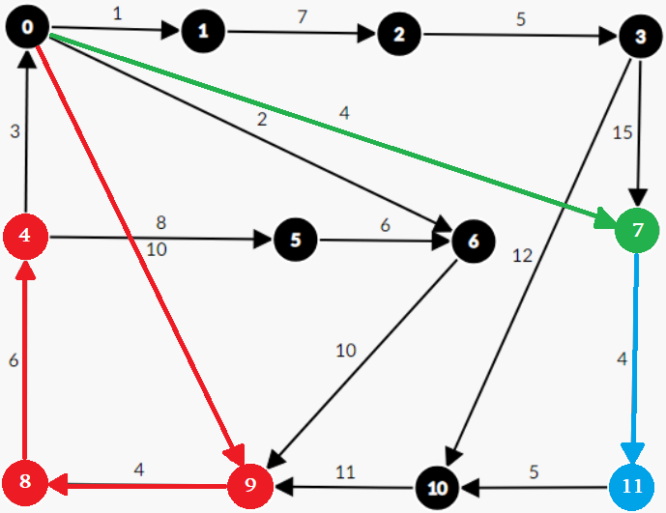
So now we should recalculate the shortest paths for all buses with new destinations So for bus 0 (0->4, 0->7, 0->11) we will have this scene
Our program will have this output Bus 0 updated destinations and durations:
Destination: 4, Duration: 20
Destination: 7, Duration: 4
Destination: 11, Duration: 8

Slide 16
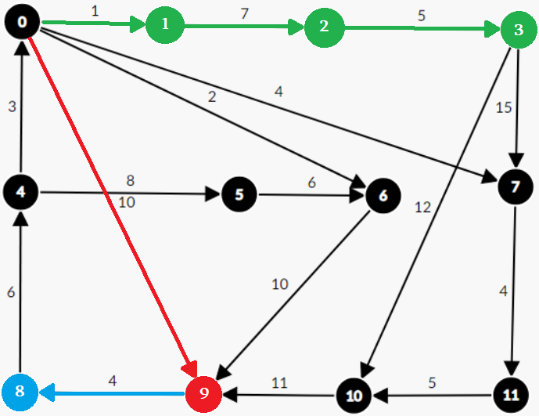
For bus 1 (0->9, 0->3, 0->8) we will have this scene
Our program will have this output Bus 1 updated destinations and durations:
Destination: 9, Duration: 10
Destination: 3, Duration: 13
Destination: 8, Duration: 14

Slide 17
Now for operation common_streets we need two functions, this is their implementation.
// Function to find shortest paths from a source node to multiple destinations in a graph
vector<vector<int>> findShortestPaths(const vector<vector<Edge>>& graph, const vector<vector<int>>& all_destinations) {
int n = graph.size(); // Number of vertices in the graph
vector<vector<int>> shortestPaths; // Vector to store shortest paths
// Iterate over all sets of destinations
for (const auto& destinations : all_destinations) {
int destination = destinations[0]; // First destination
int source = 0; // Source node
// Initialize distance, previous node, and visited arrays
vector<int> dist(n, INF);
vector<int> prev(n, -1);
vector<bool> visited(n, false);
dist[source] = 0; // Distance from source to itself is 0
// Priority queue to store vertices based on their distances
priority_queue<pair<int, int>, vector<pair<int, int>>, greater<pair<int, int>>> pq;
pq.push({0, source}); // Push source vertex with distance 0

Slide 18
// Dijkstra's algorithm to find shortest paths
while (!pq.empty()) {
int u = pq.top().second; // Extract vertex with smallest distance
pq.pop();
if (visited[u]) continue; // Skip if already visited
visited[u] = true; // Mark vertex as visited
// Relax edges from the current vertex
for (const auto& neighbor : graph[u]) {
int v = neighbor.to; // Destination vertex
int weight = neighbor.weight; // Weight of the edge
// Update distance and previous node if shorter path is found
if (dist[u] + weight < dist[v]) {
dist[v] = dist[u] + weight;
prev[v] = u;
pq.push({dist[v], v}); // Push updated distance and vertex to priority queue
}
}
}

Slide 19
// Reconstruct shortest path from source to destination
vector<int> path;
int current = destination;
while (current != source) {
path.push_back(current);
current = prev[current];
}
path.push_back(source); // Add source node to the path
reverse(path.begin(), path.end()); // Reverse the path to get source-to-destination order
shortestPaths.push_back(path); // Add shortest path to the result vector
}
return shortestPaths;
}

Slide 20
Find Common Segment function
// Function to find common segments between paths of two buses
void findCommonSegments(const vector<vector<int>>& bus1Paths, const vector<vector<int>>& bus2Paths) {
// Iterate over paths of both buses
for (const auto& path1 : bus1Paths) {
for (const auto& path2 : bus2Paths) {
int path1Index = 0, path2Index = 0; // Index for each path
bool printed = false; // Flag to track if anything is printed
bool firstSegmentPrinted = false; // Flag to track if the first segment is printed
// Traverse both paths simultaneously
while (path1Index < path1.size() && path2Index < path2.size()) {
if (path1[path1Index] == path2[path2Index]) {
// If vertices match, print the common vertex
if (firstSegmentPrinted) {
cout << "->"; // Print arrow separator
} else {
firstSegmentPrinted = true; // Mark first segment as printed
}

Slide 21
cout << path1[path1Index]; // Print common vertex
++path1Index; // Move to next vertex in path1
++path2Index; // Move to next vertex in path2
printed = true; // Mark something as printed
} else {
if (printed) {
cout << " "; // Print space separator if something was printed before
cout << endl; // Move to next line
printed = false; // Reset printed flag
}
// Move index of path1 or path2 based on which vertex is smaller
if (path1[path1Index] < path2[path2Index]) {
++path1Index;
} else {
++path2Index;
}
}
}

Slide 22
cout << path1[path1Index]; // Print common vertex
++path1Index; // Move to next vertex in path1
++path2Index; // Move to next vertex in path2
printed = true; // Mark something as printed
} else {
if (printed) {
cout << " "; // Print space separator if something was printed before
cout << endl; // Move to next line
printed = false; // Reset printed flag
}
// Move index of path1 or path2 based on which vertex is smaller
if (path1[path1Index] < path2[path2Index]) {
++path1Index;
} else {
++path2Index;
}
}
}

Slide 23
if (printed) {
cout << " "; // Print space separator if something was printed before
cout << endl; // Move to next line
}
}
}
}

Slide 24
Common Streets Operation
else if (operation == "common_streets") {
int I, J;
cin >> I >> J; // Input bus indices
// Get destinations for buses I and J
vector<vector<int>> destinationsI, destinationsJ;
for (const auto& dest_time : buses[I]) {
int destination = dest_time.first;
destinationsI.push_back({destination});
}
for (const auto& dest_time : buses[J]) {
int destination = dest_time.first;
destinationsJ.push_back({destination});
}

Slide 25
// Find shortest paths for destinations of buses I and J
vector<vector<int>> shortestPathsI = findShortestPaths(graph, destinationsI);
vector<vector<int>> shortestPathsJ = findShortestPaths(graph, destinationsJ);
// Find and print common segments between paths of buses I and J
findCommonSegments(shortestPathsI, shortestPathsJ);
}

Slide 26
common_streets 0 1 ( bus 0 and bus 1 common streets)
Bus 0 Bus 1

Slide 27
We are comparing bus 0 all destinations paths with bus 1 all destinations path, after this operation we will have this output
0->6->9
0 (no common thing)
0->6->9->8
0 (no common thing)
0->1->2->3
0 (no common thing)
0 (no common thing)
0->1->2->3
0 (no common thing)

